Slide 1

Toward a New Experimental Paradigm for Consumer BCI
Problem Identification | Data Wrangling | Exploratory Data Analysis | Preprocessing | Modeling | Documentation
Walter Piper
July 2021
Capstone Presentation

Slide 2
Outline
Problem Identification | Data Wrangling | Exploratory Data Analysis | Preprocessing | Modeling | Documentation
Context for consumer EEG
Problem Identification and proposed framework
Data Wrangling and Data Engineering
Exploratory Data Analysis
Preprocessing & Modeling
Recommendations & Future Directions

Slide 3
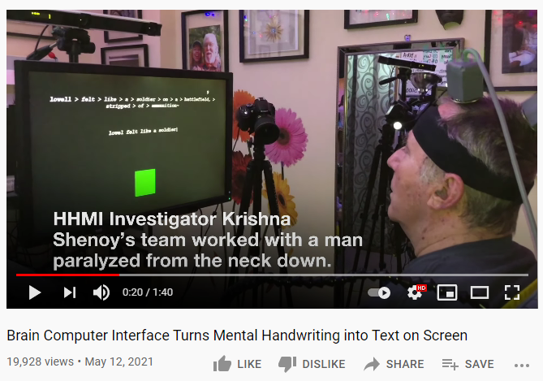
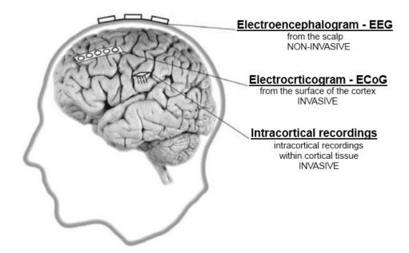
Brain-Computer Interfaces are having a moment
Problem Identification | Data Wrangling | Exploratory Data Analysis | Preprocessing | Modeling | Documentation
Brain Sci. 2021, 11, 43. https://doi.org/10.3390/brainsci11010043 https://www.mdpi.com/journal/brainsci
Notes:
Key determinants of brain signal utility:
Spatial : Proximity to neurons / Num Channels
Temporal : Sampling rate
Practical : Cost / Invasive vs. Non-Invasive

Slide 4
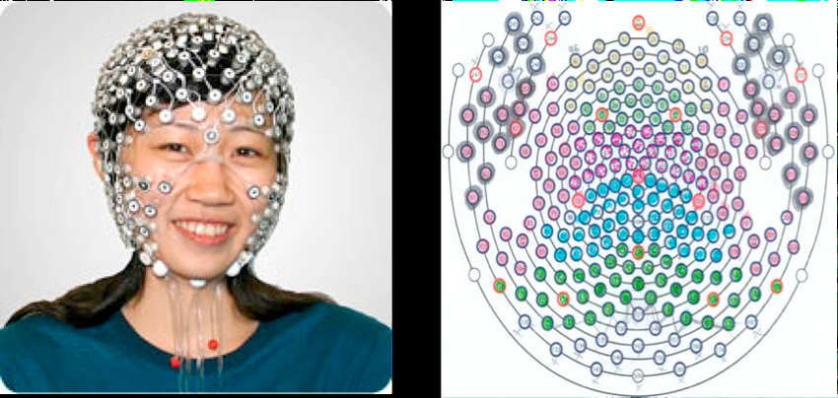
Can non-invasive interfaces also thrive?
Problem Identification | Data Wrangling | Exploratory Data Analysis | Preprocessing | Modeling | Documentation
Limitations:
Distance from source of signal
Potentially expensive $$$
“Prices for a complete EGI Geodesic configuration range from approximately $30,000–$175,000”
Notes:
Very limited in functionality compared to invasive interfaces.

Slide 5
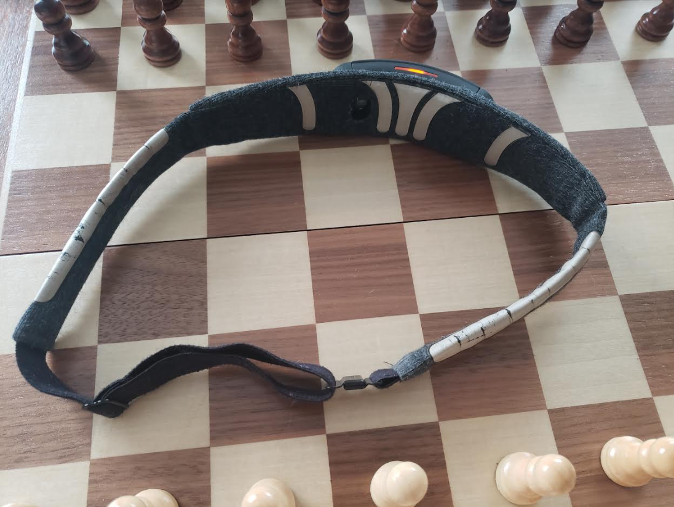
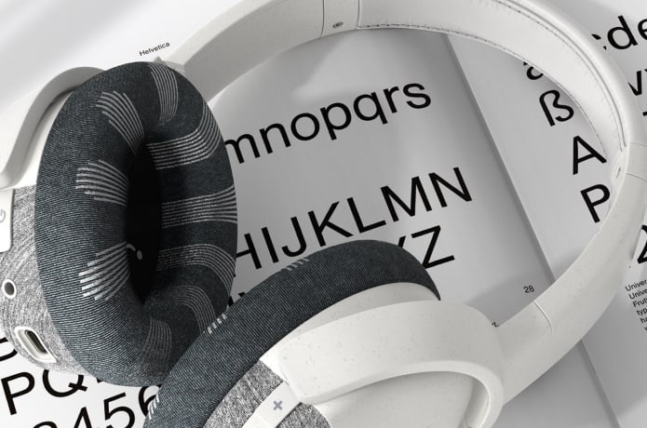
Problem Identification
Problem Identification | Data Wrangling | Exploratory Data Analysis | Preprocessing | Modeling | Documentation
Challenges:
Few consumer options at affordable price point.
Few channels and noisy data.
Limited use cases, so far.
Strategies:
Market for precise use cases.
Make the most of noisy data.
Machine Learning
Supplemental data (ex. gyroscope)
$300 Examples:
Interaxon’s Muse meditation headband (2014)
Neurable’s Enten headphones (2022)

Slide 6

Consumer-Driven Discovery and Deployment
Problem Identification | Data Wrangling | Exploratory Data Analysis | Preprocessing | Modeling | Documentation
Exploratory Data Analysis & Feature Engineering
Modeling
Real-Time Deployment
Curiosity & Hypothesis Generation
Self-Experimentation
Automate as much as possible to make BCI experimentation accessible to others.

Slide 7
My own hypotheses to test:
Problem Identification | Data Wrangling | Exploratory Data Analysis | Preprocessing | Modeling | Documentation
I am interested in asynchronous control.
I would love the ability to mentally recruit my computer to perform an action.
0. Baseline condition = open eyes
Experimental conditions:
Test if imagined/mental commands can be distinguished from baseline.
Test if body-focused attention (body-scan meditation) can be identified.
Positive control (Try to reproduce a known effect):
Eyes open should be separable from eyes closed. (alpha frequencies ~10Hz)
Additional control condition:
Test if physical action (repeated button pressing) can be separated from mental action command.

Slide 8
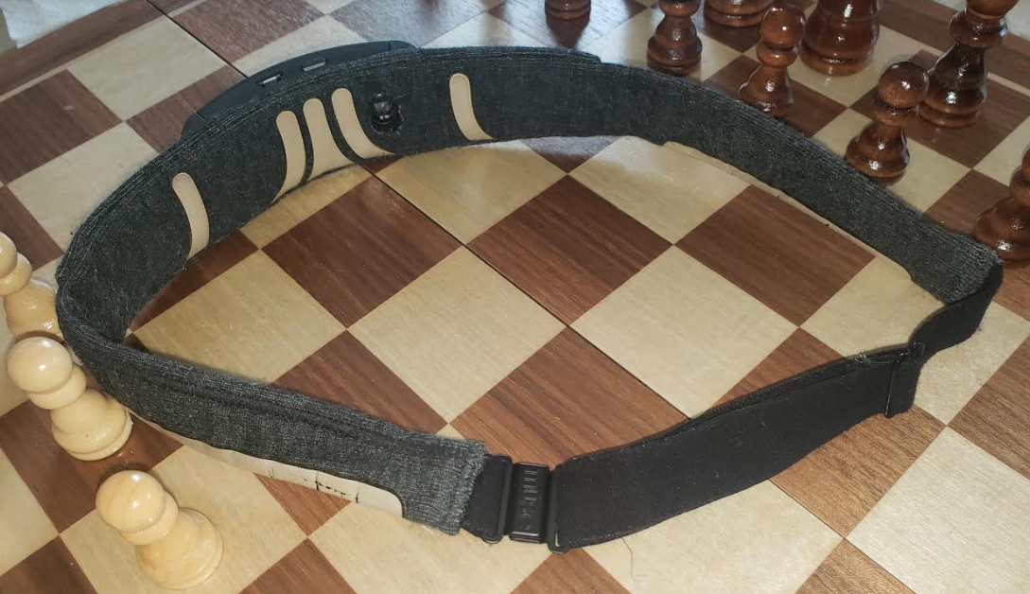
Muse headband has electrodes over frontal lobe & temporal lobe.
Problem Identification | Data Wrangling | Exploratory Data Analysis | Preprocessing | Modeling | Documentation
Ground &
Reference Electrodes
Frontal electrodes
AF7, AF8
Low noise.
Eye-movement artifacts
Temporal (side) electrodes
TP9, TP10
High noise
Muscle tension in jaw and neck.
Poor fit.
EEG signal often overwhelmed by muscle activity and heartbeat.
Accelerometer & Gyroscope
From a neuroscience theory perspective:
Frontal-Temporal coordination is heavily involved in cognitive-emotional integration
AF8
TP10
TP9
AF7

Slide 9
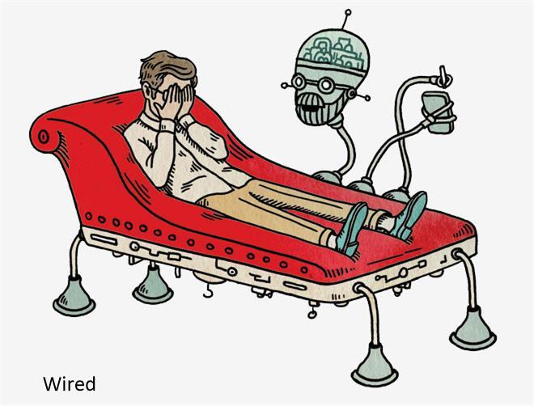
Behavioral experiments can be automated
Problem Identification | Data Wrangling | Exploratory Data Analysis | Preprocessing | Modeling | Documentation
Allow computer to handle timing and data.
Instructions to human via Text-To-Speech (TTS).
Reduces movement artifacts and improves temporal precision
Exploratory Data Analysis & Feature Engineering
Modeling
Real-Time Deployment
Curiosity & Hypothesis Generation
Self-Experimentation

Slide 10

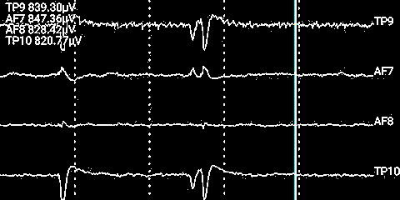



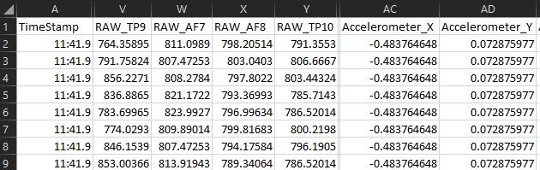


Data Pipelines – Data Collection
Problem Identification | Data Wrangling | Exploratory Data Analysis | Preprocessing | Modeling | Documentation
Muse EEG headband
Mind Monitor app
DATA FLOW
Bluetooth
Option 2:
OSC network protocol
Option 1:
.csv file
python-osc
(Multi-threading server mapping message strings to handler functions)
PYTHON FLOW
pyttsx3
(Text-To-Speech instructions during experiment)
queue.Queue
Thread to stop server at end.
pymongo/MongoDB
(Database for long-term storage)

Slide 11
Data Pipelines – Real-Time Implementation
Problem Identification | Data Wrangling | Exploratory Data Analysis | Preprocessing | Modeling | Documentation
Muse EEG headband
Mind Monitor app
DATA FLOW
Bluetooth
Option 2:
OSC network protocol
Modified version for deployment
python-osc
(Multi-threading server mapping message strings to handler functions)
PYTHON FLOW
Visual or audio feedback
Prediction Model
(scikit-learn or keras)
pymongo/MongoDB (Capped Collection for immediate prediction)

Slide 12
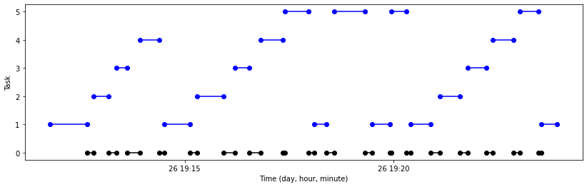
Data Wrangling - .csv file
Problem Identification | Data Wrangling | Exploratory Data Analysis | Preprocessing | Modeling | Documentation
3 experiment recordings were combined to form a dataset for modeling.
Without python control during recording, experimental conditions were marked manually in the Mind Monitor app.
Data was sorted into overlapping 2-second epochs, then mean and var of all numeric variables were computed as features.
5 = Eyes closed
4 = Body-scan
3 = Physical action
(Repeated button pressing)
2 = Mental action command
(Repeatedly willing something to happen)
1 = Baseline

Slide 13
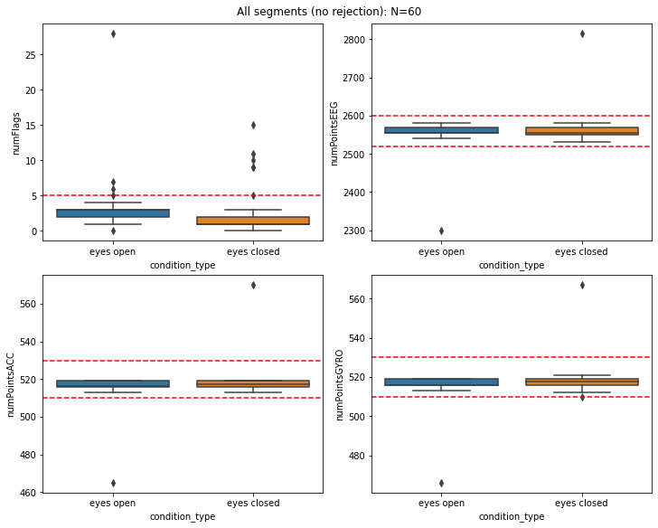
Data Wrangling – OSC Protocol
Problem Identification | Data Wrangling | Exploratory Data Analysis | Preprocessing | Modeling | Documentation
OSC messages included raw signal from EEG, accelerometer, gyroscope, and quality control flags.
10-second segments were rejected:
if 5 or more flags were present.
If the number of saved datapoints differed by more than 1.5%.
12 out of 60 segments were rejected.

Slide 14
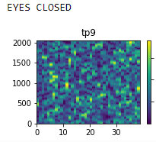
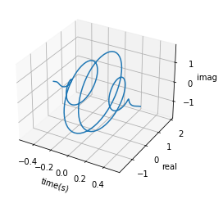
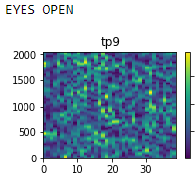
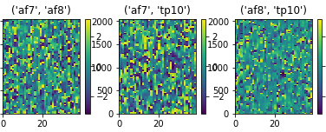
Visualizations in Exploratory Data Analysis
Problem Identification | Data Wrangling | Exploratory Data Analysis | Preprocessing | Modeling | Documentation
AMPLITUDE
Exploratory Data Analysis & Feature Engineering
Modeling
Real-Time Deployment
Curiosity & Hypothesis Generation
Self-Experimentation
COMPLEX MORLET WAVELET
Time →
Frequency →
PHASE DIFF BETWEEN CHANNELS
AMPLITUDE
Time →
Time →
Frequency →
Rely on visualizations to understand the brain’s non-linear dynamics.
Frequency →

Slide 15
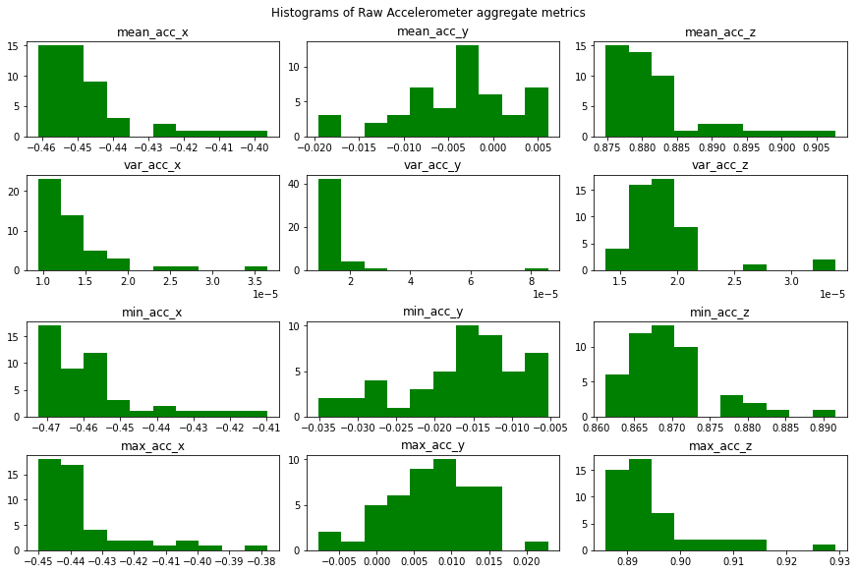
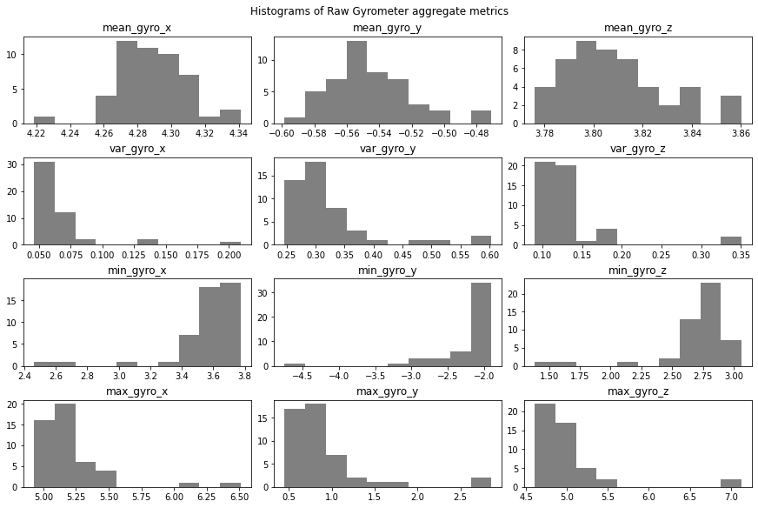
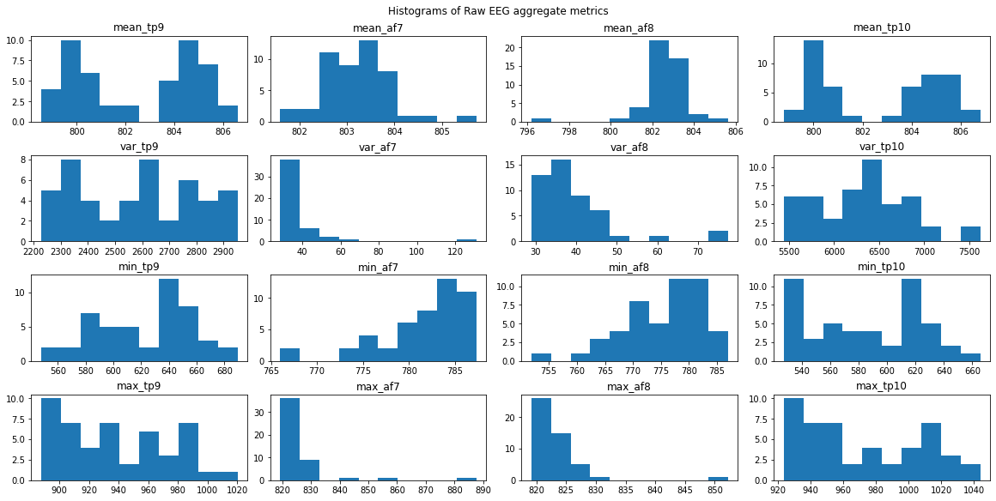
Univariate distributions
Problem Identification | Data Wrangling | Exploratory Data Analysis | Preprocessing | Modeling | Documentation

Slide 16
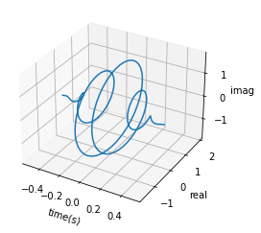
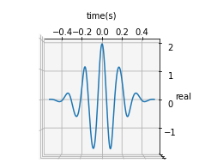
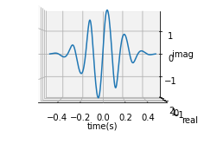
Complex Morlet Wavelets
Problem Identification | Data Wrangling | Exploratory Data Analysis | Preprocessing | Modeling | Documentation
AMPLITUDE
A sine wave times a Gaussian, with Euler’s formula to expand into imaginary space.
A single convolution with a wavelet can compute:
Band-pass signal
Amplitude
Power
Phase (phase difference between channels is informative)
Time →
PHASE DIFF BETWEEN CHANNELS
Frequency →
Time →
AMPLITUDE
Time →
Frequency →
Frequency →

Slide 17
Challenges of EEG signal
Problem Identification | Data Wrangling | Exploratory Data Analysis | Preprocessing | Modeling | Documentation
Highly non-linear dynamics make dimensionality reduction complicated.
Unclear whether signal is more predictive when aggregated over a time segment (with mean & var), or if sequence information should be retained.
Given the small size of my early dataset (several hundred 2-second segments), I elected to aggregate.
I used a custom train-test process to separate the final 20% of each condition type from each of the 3 recordings as a test set.
Employed GridSearchCV with pipelines.
AMPLITUDE
AMPLITUDE
Time →
Time →
Frequency →
Frequency →

Slide 18
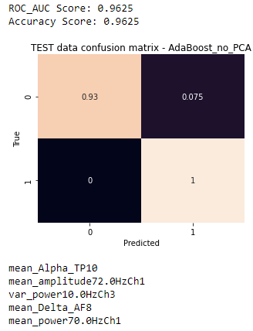
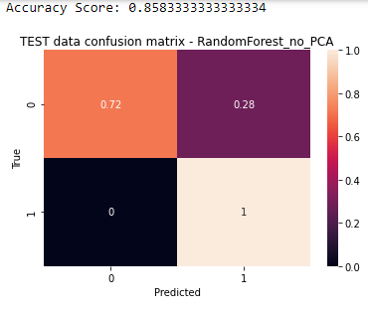
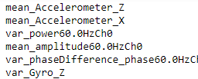
Efficient modeling
Problem Identification | Data Wrangling | Exploratory Data Analysis | Preprocessing | Modeling | Documentation
Exploratory Data Analysis & Feature Engineering
Modeling
Real-Time Deployment
Curiosity & Hypothesis Generation
Self-Experimentation
Favor model types with easily accessible feature importances.

Slide 19
Cross-validation model search
Problem Identification | Data Wrangling | Exploratory Data Analysis | Preprocessing | Modeling | Documentation
2-second segments were fed into 12 scikit-learn pipelines:
StandardScaler()
{PCA, or no PCA}
{ One of six model types:
# Support Vector Classifier
# Linear Discriminant Analysis
# Random Forest Classifier
# AdaBoost Classifier
# Gradient Boosting Classifier
# Decision Tree Classifier}
Baseline (open eyes) vs Closed Eyes

Slide 20
Consumer-Driven Discovery and Deployment
Problem Identification | Data Wrangling | Exploratory Data Analysis | Preprocessing | Modeling | Documentation
Exploratory Data Analysis & Feature Engineering
Modeling
Real-Time Deployment
Curiosity & Hypothesis Generation
Self-Experimentation
Identify the most important subset of features.
Deploy a lightweight model.
The proximity to deployment lowers the opportunity cost of false positives.

Slide 21
Recommendations
Problem Identification | Data Wrangling | Exploratory Data Analysis | Preprocessing | Modeling | Documentation
Important features appear to be power/amplitude throughout the tested frequency range of 2Hz-80Hz.
Variance in phase difference between channels appears to be structured.
Phase diff is more stable within a brain hemisphere than across hemispheres.
Phase shifts are known to reflect functional connectivity between brain regions.
Cross-correlation analysis like Granger Causality may yield good results.
Wavelet convolution methods are effective.

Slide 22
Recommendations
Problem Identification | Data Wrangling | Exploratory Data Analysis | Preprocessing | Modeling | Documentation
Decision tree ensemble methods can be very effective in an unknown feature space.
Support vector classifiers may be best for well-understood feature spaces.
Parallel pipelines for binary classification may be more effective than a single multiclass predictor.
Consumer EEG interfaces like Muse may have undiscovered potential.
Automate experimentation for the benefit of consumers.

